Slide 1
Estimating the Work
A Module in Agile Fundamentals
This work is licensed under the
Creative Commons Attribution-ShareAlike 4.0 International License.
To view a copy of this license, visit http://creativecommons.org/licenses/by-sa/4.0/.
Notes:
Plan, execute and report on Agile projects
--------------------------------------------------------------------------------------------------------------------
In this module, we’ll explore the practices that help Managers and Project Managers plan, execute, and report on Agile projects.
1
Estimating the Work

Slide 2
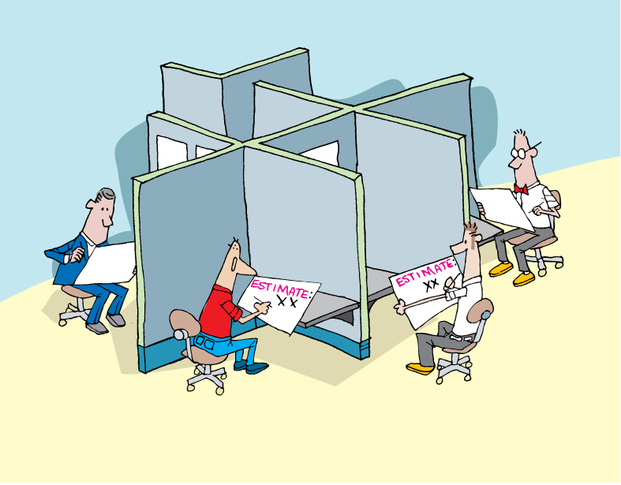
Notes:
We do not want to rely on individual estimates, certainly not from those who will not be delivering the project.
Do you do this now?
2
Estimating the Work

Slide 3

Estimating the Effort
Notes:
Accuracy – degree of closeness
Precision – reproducibility or repeatability
Results of calculations or measurements can be:
Accurate but not precise
Precise but not accurate
----------------------------------------------------------------------------------------------------------
Agile estimation is one of the parts that folks new to Agile struggle with. In this section, we’ll dig into the why and the how, and then give you some very specific practices.
Let’s begin with gaining an understanding of the terms “accuracy” and “precision”.
From Wikipedia, we get this definition: [CLICK]
In the fields of science, engineering, industry and statistics, accuracy is the degree of closeness of a measured or calculated quantity to its actual (true) value.
Accuracy is closely related to precision, also called reproducibility or repeatability, the degree to which further measurements or calculations show the same or similar results.
The results of calculations or a measurement can be accurate but not precise, precise but not accurate, neither, or both. A measurement system or computational method is called valid if it is both accurate and precise. The related terms are bias (non-random or directed effects caused by a factor or factors unrelated by the independent variable) and error (random variability), respectively.
3
Estimating the Work

Slide 4


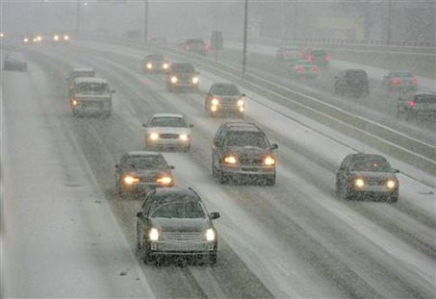
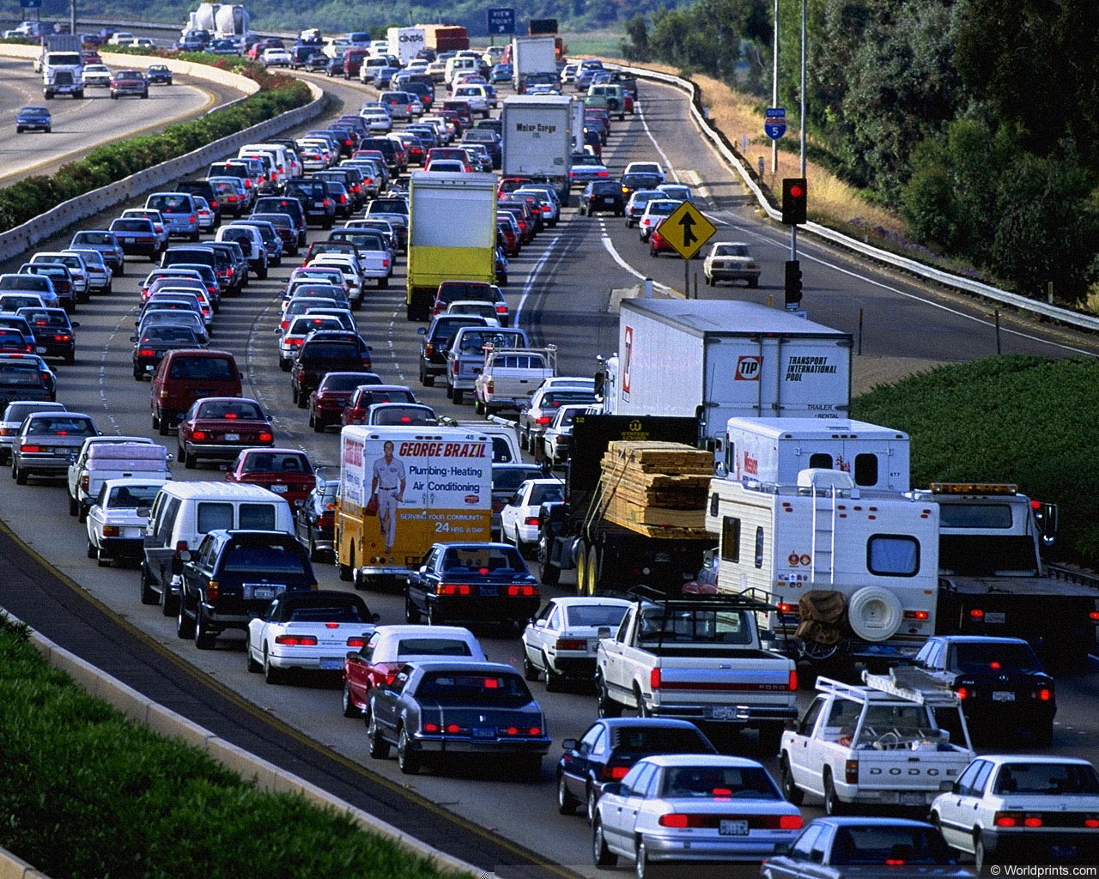
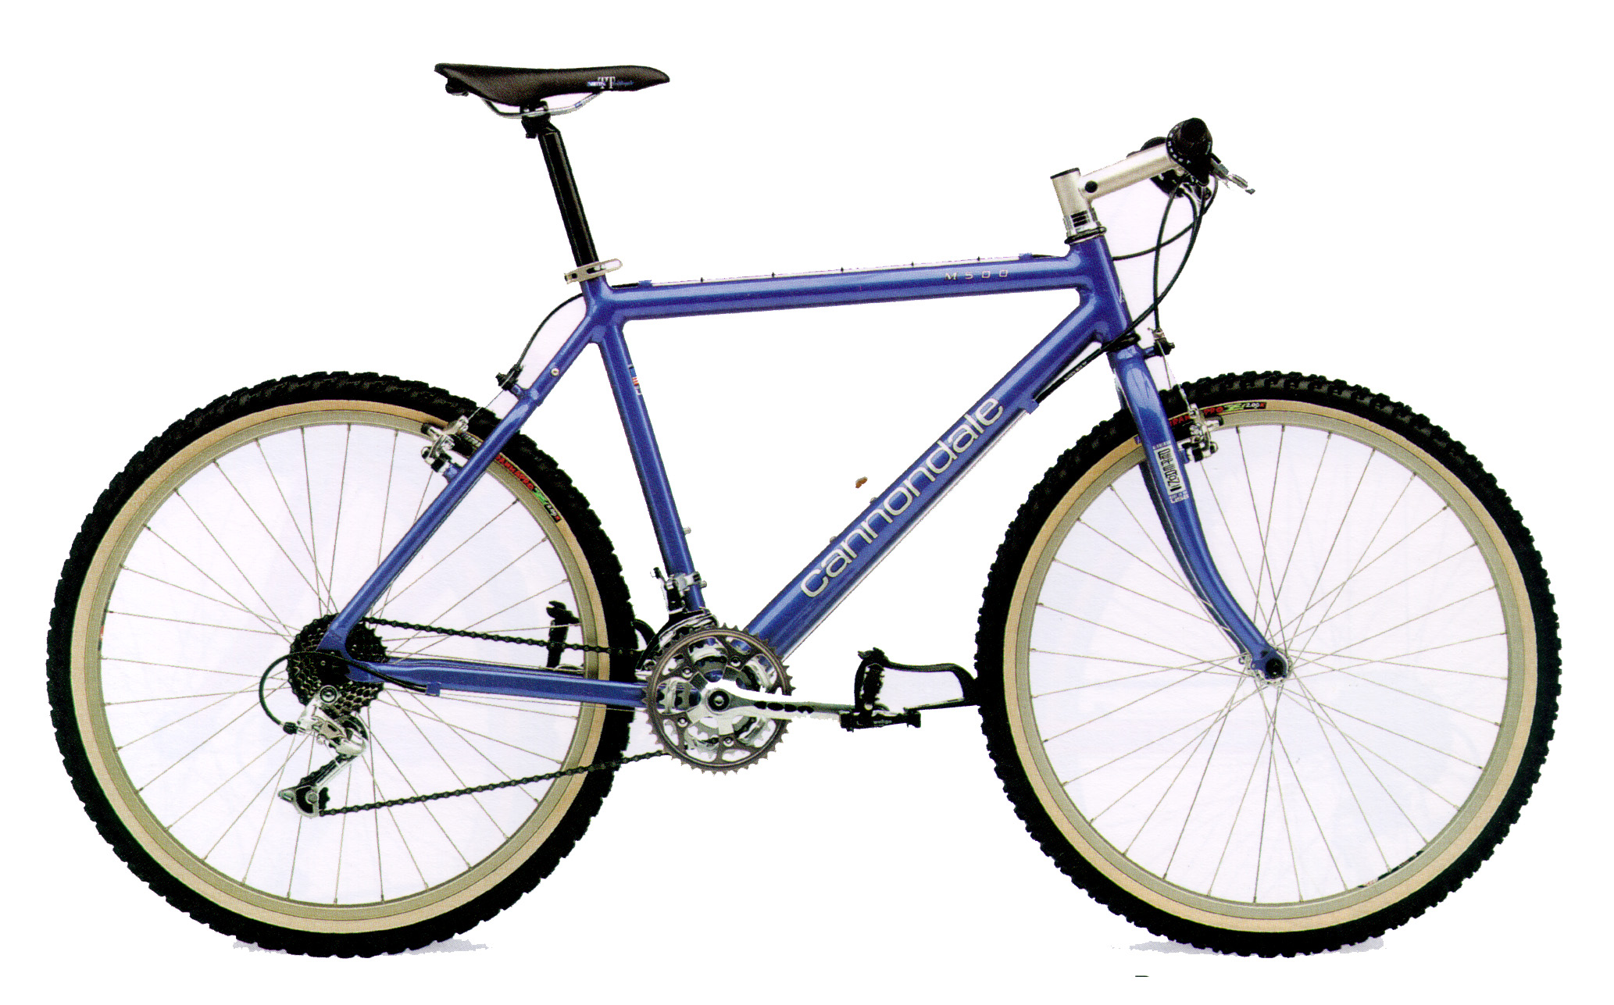
Distance to the airport from here?
Notes:
What is the distance from here to the airport?
How long does it take to get there?
Variables – traffic conditions, mode of transportation, weather – all make a huge difference in the time it takes to arrive, yet the distance remains constant.
Same with writing software – lots of things affect how long it takes to get to “done” – what are they here? (support, interruptions, meetings, etc.).
So we take a 2-part approach to agile estimating – relative size (effort, complexity) of each story, and how fast we can get work done.
We will look at relative size first.
4
Estimating the Work

Slide 5

Speed Vs Volume (Story Points)
Notes:
Stuff about volume rather than speed
Estimating the Work
5

Slide 6
Relative Sizing Tips
All stories are sized relative to another
Sort out the stories and find the smallest
Size all other stories relative to that one.
Twice as big, three times as big, etc

Slide 7
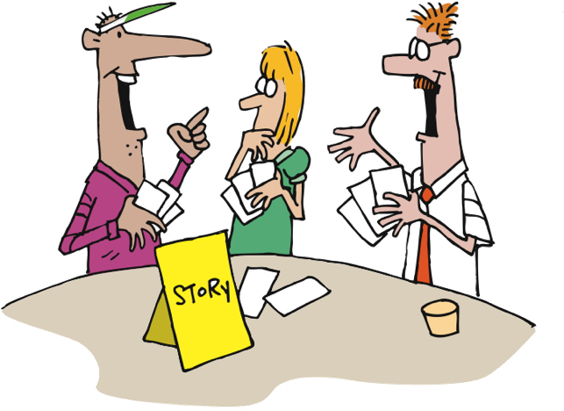
Agile Estimation
Notes:
How does it work?
First the BA presents the story to the team.
Then everyone thinks about the estimate [CLICK]
Then everyone throws their estimate at the same time
No one is influenced by anyone else [CLICK]
There may be outliers [CLICK]
There is discussion about the outliers [CLICK]
Everyone re-thinks [CLICK]
Then re-throw
Sometimes necessary, sometimes not
----------------------------------------------------------------------------------------------------------------
Let’s look at how it’s done…
First, we gain a clear understanding of the story, including the acceptance criteria and the tasks needed to complete the story. Once all members of the team feel that they have that understanding, each member of the team selects the number that they feel represents the relative complexity of the story, as compared to other stories that the team has implemented.
As a group, [CLICK] team members reveal their estimates – the numbers they have chosen, that is. Revealing all at once prevents any team member from being influenced by another team member’s estimate.
It’s not unusual for there to be outliers [CLICK] – estimates that are different from the majority. When this happens, [CLICK] the team discusses the differences. Some will have thought of other tasks, or understood the tasks differently. Sometimes it’s QA who sees things differently. [CLICK]
Regardless, after discussing things, the team [CLICK] estimates again. If it takes more than three rounds of estimating, there’s a smell that needs to be addressed. The story may need to be rewritten or more analysis may need to be done.
Of course, sometimes the people who have thrown the outliers will agree to change their estimates without another round of estimating, once they understand the thinking of their teammates. In this case, no additional rounds of Planning Poker are needed for that story.
Estimating the Work

Slide 8
Agile Estimation
Discuss only if there is disagreement
If everyone agrees, then there is no need to discuss
Discuss the unknowns – “Why do you think it’s a…”
Don’t try to convince people to change
Re-throw
Notes:
This variation is one that we have used. We throw 1, 2, or 3 as valid estimates. 5 is NOT a valid estimate and means “I have no idea”. If someone throws that then we need to have a conversation.
Teams may have their own variations on this. Sometimes people can abstain by throwing “rock” (a fist).
Note: demonstrate to them the counting in strategy you will use! “One, two, three, throw!”
From Martin Fowler’s website: http://martinfowler.com/bliki/ThrownEstimate.html
Estimating the Work

Slide 9
How much can we do?
Notes:
Low: 1min
High: 3min
9
Estimating the Work

Slide 10
How to Derive a Planning Velocity
Experience
Accuracy
Trial Iterations
Velocity Planning Games
Educated Guess
Effort/Time
Notes:
The line represents project start.
Educated guess using data from previous projects is risky. You must determine the variables that were in play on the other project(s) compared to this project.
Trial iteration. Costly, but most accurate for planning.
Velocity planning game. More risky. Likely to be modified.
---------------------------------------------------------------------------------------------------------------
Experienced Agile teams will set expectations for a fairly steady ramp up in velocity over time as the team forms and early uncertainties get ironed out. But the question remains – what planning velocity shall we ramp up to? As with all estimation activities, experience is an invaluable contributor but hard data is going to be the biggest factor, hence the option of using a trial iteration. As heavyweight as this sounds, taking just two weeks to provide a good set of real data for future planning over the course of a 20 week project is probably not a bad investment.
For people looking for a cheap way of obtaining a planning velocity, do be wary of using an data from previous projects, even with the same group of people. As easy as this may sound, there are so many variables unaccounted for that any planning you do is really little more than an educated guess.
Low: 1 min
High: 3 min
10
Estimating the Work

Slide 11
How long?

Slide 12

How many iterations?
As a user I need to blah blah so that blah
4
2
Story Point Estimates
As a user I need to blah blah so that blah
As a user I need to blah blah so that blah
4
As a user I need to blah blah so that blah
2
Estimated Iteration Velocity
As a user I need to blah blah so that blah
1
As a user I need to blah blah so that blah
8
User Stories
(Points per iteration)
Total Story Points
/ Estimated Velocity
= Number of Iterations
Notes:
Need to answer the questions of:
How long will it take?
How much will it cost?
Other things can impact velocity, like ramp up, scheduled absences, etc, and should be factored in the plan
Low: 1 min
High: 3 min
12
Estimating the Work

Slide 13
Raw Velocity
Estimated Velocity Per Pair X Steady State Pairs = Raw Velocity Per Iteration
POINTS
TIME
Total Story Points / Raw Velocity Per Iteration = Rough Number of Iterations

Slide 14
Add Non-Dev Time and Risk
Add whatever time is necessary on either end, and you have your total estimated duration range
UAT
Beta
GA
Initiation
UAT
Beta
GA
POINTS
TIME

Slide 15
Questions?
Notes:
15
Estimating the Work

